Slide 1
Accounting Information Systems
PRESENTED BY: EDGAR OTIENO
Lecture 3
Documenting Transaction Cycles: Data Flow Diagrams; System Flow charts
Notes:
2

Slide 2
Objectives for Lecture 2
Broad objectives of transaction cycles
Types of transactions processed by each of the three transaction cycles
The basic accounting records used in TPS
The traditional accounting records and their magnetic equivalents
Documentation techniques
Batch and real-time processing and the impact of these technologies on transaction processing
Notes:
2

Slide 3
A Financial Transaction is...
an economic event that affects the assets and equities of the firm, is reflected in its accounts, and is measured in monetary terms.
similar types of transactions are grouped together into three transaction cycles:
  the expenditure cycle,
  the conversion cycle, and
  the revenue cycle.
Notes:
2

Slide 4
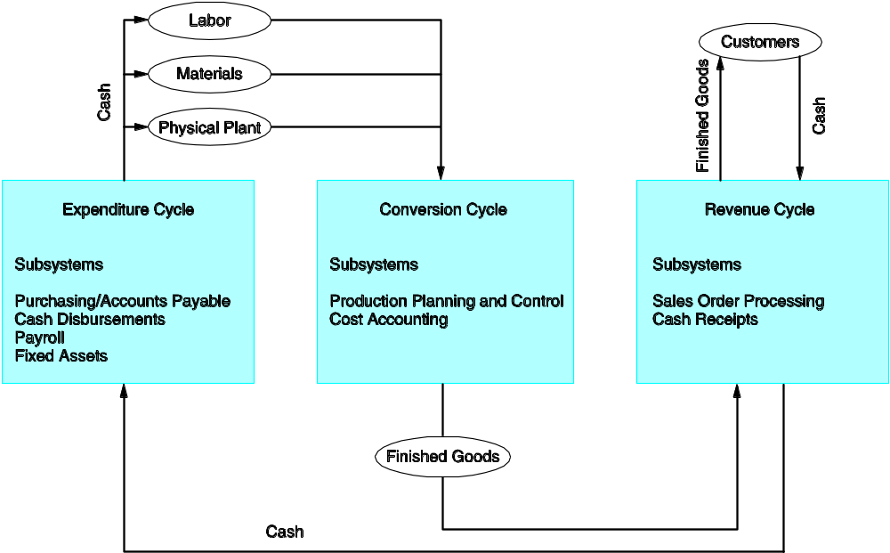
Relationship between Transaction Cycles

Slide 5
Each Cycle has Two Subsystems
Expenditure Cycle: time lag between the two subsystems due to credit relations with suppliers:
  physical component (acquisition of goods)‏
  financial component (cash disbursements to the supplier)‏
Conversion Cycle :
  the production system (planning, scheduling, and control of the physical product through the manufacturing process)‏
  the cost accounting system (monitors the flow of cost information related to production)‏
Revenue Cycle: time lag between the two subsystems due to credit relations with customers :
  physical component (sales order processing)‏
  financial component (cash receipts)‏
Notes:
5

Slide 6
Manual System Accounting Records
Source Documents - used to capture and formalize transaction data needed for transaction processing
Product Documents - the result of transaction processing
Turnaround Documents - a product document of one system that becomes a source document for another system
Journals - a record of chronological entry
  special journals - specific classes of transactions that occur in high frequency
  general journal - nonrecurring, infrequent, and dissimilar transactions
Ledger - a book of financial accounts
  general ledger - shows activity for each account listed on the chart of accounts
  subsidiary ledger - shows activity by detail for each account type
Notes:
5

Slide 7
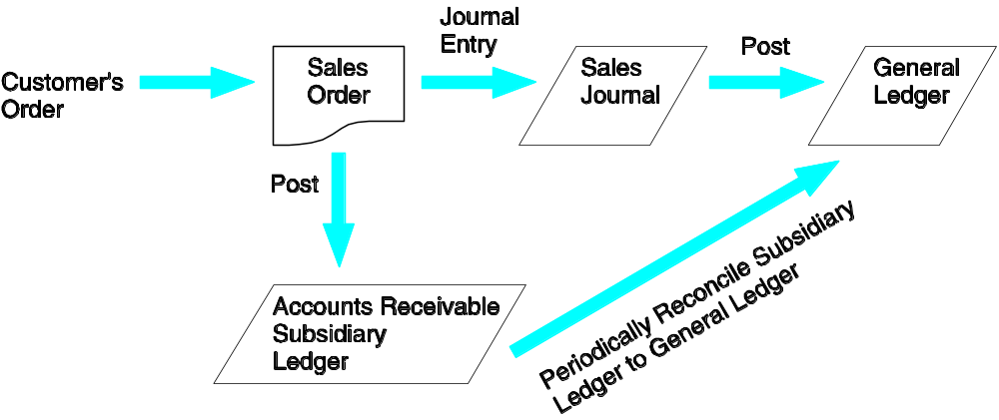
Flow of Economic Events Into the General Ledger
Notes:
17

Slide 8
Computer Files
Master File - generally contains account data (e.g., general ledger and subsidiary file)‏ - mostly change existing fields
Transaction File - a temporary file containing transactions since the last update – mostly add new records
Accounts Receivable (AR) file: Add record for new credit sale; adjust balance owing when money paid → Qn: What type of file is the AR file?
Reference File - contains relatively constant information used in processing (e.g., tax tables, standard costs)‏
Archive File - contains past transactions for reference purposes
Notes:
20

Slide 9
Computer-Based Systems
The audit trail is less observable in computer-based systems than traditional manual systems.
The data entry and computer programs are the physical trail.
The data are stored in magnetic files.
Notes:
19

Slide 10
How would we verify the Accounts Receivable balance?
Accounts Receivable Control Account-General Ledger
Accounts Receivable Subsidiary Ledger
(sum of all customers’ receivables)‏
Sales Journal
Cash Receipts Journal
Sales Order
Deposit Slip
Shipping Notice
Remittance Advice
Notes:
18

Slide 11
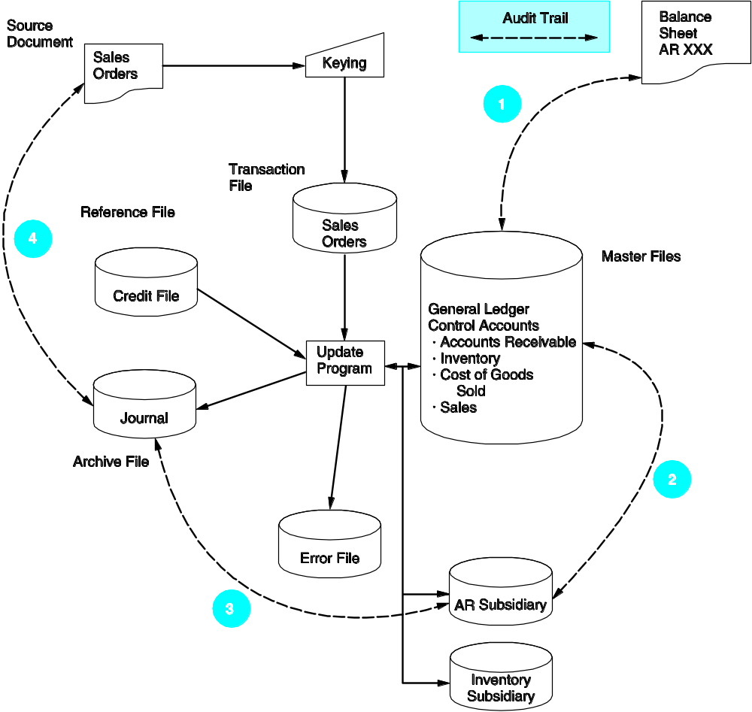
Accounting Records in a Computer-Based System
EXPLANATION OF STEPS IN FIGURE:
1. Compare the AR balance in the balance sheet with the master file AR control account balance.
2. Reconcile the AR control figure with the AR subsidiary account total.
3. Select a sample of update entries made to accounts in the AR subsidiary ledger
and trace these to transactions in the sales journal (archive file).
4. From these journal entries, identify source documents that can be pulled from their files and verified. If necessary, confirm these source documents by contacting the customers.
Notes:
17

Slide 12
Documentation Techniques
Documentation in a Computer Based environment is necessary for many reasons.
Five common documentation techniques:
  Entity Relationship Diagram/REA model
  Data Flow Diagrams
  Document Flowcharts
  System Flowcharts
  Program Flowcharts
Notes:
19

Slide 13
Entity Relationship Diagram (ERD)…
Is a documentation technique to represent the relationship between entities in a system.
The REA model version of ERD is widely used in AIS. REA uses 3 types of entities:
  resources (cash, raw materials)‏
  events (release of raw materials into the production process)‏
  agents (inventory control clerk, vendor, production worker)‏
Notes:
21

Slide 14
Types of Events in REA
Operational events[day to day activities of an event such as buying and selling]
Informational events[events used to add knowledge about a given process e.g how to improve sales]
Decision Support events[events relevant for strategic planning e.g financial statements]
*REA focuses on operational events ONLY

Slide 15
Steps in REA modelling
Identify the Events
Identify the sequence of these events
Identify the resources required by these events
Determine the links/mapping between these events[mapping between events and resources]
Identify the associations between the events themselves

Slide 16
Cardinalities
Entity
Relationship
Entity
1
1
Car
Type
Sales-
person
Assigned
1
M
Customer
Places
Order
M
M
Vendor
Supply
Inventory
Notes:
23

Slide 17
Cardinalities…
Are part of the description of the relationship between entities in an ER diagram.
They represents the numerical mapping between entities:
  one-to-one
  one-to-many
  Many-to-many
Entities map to database tables in a relational database. Also, extra tables exist for relationships in many-to-many relationships.
e.g. Unversity database might have tables → students, courses, and courses taken by students
Notes:
22

Slide 18
Data Flow Diagrams (DFD)…
use symbols to represent the processes, data sources, data flows, and entities in a system
Why? These diagrams clarify the information flows through the AIS. Also shows how different elements of the system relate to each other.
We need this documentation to get a complete picture of the system
Nb. Slightly different symbols are used in different texts – the next slide shows the symbols used in the Hall text
DFD's in Hall are logical information flows through the firm, but do not represent the actual flows of goods.
Other texts also discuss physical DFDs (see Gelinas “handout” on website)‏
Notes:
24

Slide 19
Data Flow Diagrams (DFD)…
What is the relationship between ER diagrams and DFDs?
A DFD is a model of a systems processes while and ER diagram models the data used in the system as depicted in the DFD.
eg. figure 2-13 shows a DFD for the sales order processing system while figure 2-15 shows one view of its ER model.
In this course we will be using the REA data model as the ER diagram as it provides more information than a traditional ER model.
eg. REA models the exchange process – I give you money when you give me goods.
Notes:
24

Slide 20
Data Flow Diagram Symbols
Entity
Name
Data Store
Name
N
Process
Description
Direction of
data flow
Notes:
25

Slide 21
Context Diagrams, Physical DFDs and Logical DFDs
Consider the Gelinas document on the website. 3 Different types of diagrams:-
  Context diagram
  Physical DFD
  Logical DFD
Context diagram is top level. It depicts the links between the system of interest and its suroundings.
Only one “bubble” (internal entity) and many external entities.
Note: no links between external entities; goods are NOT data UNLESS they carry documents such as bill of lading etc.
Notes:
26

Slide 22
Context Diagrams, Physical DFDs and Logical DFDs
Physical DFD explodes context diagram into different levels. It shows who is doing what in the system.
There are different levels of DFDs – level 0, 1, 2, etc
More aggregated information at lower levels.
Consists of information processing activities (entities) which:-
  transform data
  retrieve data from storage
  file date
The sending and receiving of data between entities are not information processing activities because no data is transformed.
Notes:
26

Slide 23
Context Diagrams, Physical DFDs and Logical DFDs
The internal entities are names of things (people, departments, etc) that transform data (e.g cashier).
(Internal entities in logical DFDs are verbs (eg. capture cash receipts)).
The external entities in physical (and logical) DFD should be exactly the same as for context diagram.
Logical DFD is similar to physical except that internal entities are logical actions → same rules apply to these as for physical DFDs.
Physical DFDs show system as it is implemented, while logical DFD shows the logical functions independent of the way they are implemented
Notes:
26

Slide 24
Context Diagrams, Physical DFDs and Logical DFDs
Thus, physical DFD may show mailroom collecting cash receipts from customers by mail, the logical DFD would show a “capture cash receipts” function – see Gelinas fig 3.11 & 3.12.
This “capture cash receipts” function could be implemented a number of ways other than using a mailroom (eg. electronic receipt of cash through EDI).
Make sure DFDs are balanced → same external entities and data stores.
Lets work through an example – see Causway Cash receipts system – Gelinas pp.80-89
Notes:
26

Slide 25
Documents Flowcharts…
Illustrate the relationship among processes and the documents that flow between them
contain more details than data flow diagrams
clearly depict the separation of functions in a system
Try an example:-
1. A clerk in the sales department receives customer orders by mail and prepares four copies of the sales order.
2. Copy 1 of the sales order is sent to the credit department for approval. The other 3 copies and the original customer order are filed temporarily pending credit approval.
Notes:
26

Slide 26
Documents Flowcharts…
3. The credit department clerk validates the customer order against the credit records kept in the credit department. The clerk signs copy 1 to signify approval and returns it to the sales clerk.
4. When the sales clerk receives credit approval, they file copy1 and the customer order in the department. The clerk sends copy 2 to the warehouse and copies 3 & 4 to the shipping department.
5. The warehouse clerk picks the products from the shelves, records the transfer in the stock records, and sends the products and copy 2 to the shipping department.
Notes:
26

Slide 27
Symbol Set for Document Flowcharts
Terminal showing source
or destination of documents
and reports
Calculated batch total
Source document or
report
On-page connector
Manual operation
Off-page connector
File for storing source
documents and
reports
Description of process
or comments
Accounting records
(journals, registers,
logs, ledgers)
Document flowline
Notes:
27

Slide 28
Sales Department
Credit Department
Warehouse
Shipping Department
Customer
Customer
Order
Prepare
Sales
Orders
Sales
Order #1
Sales
Order #1
Sales
Order #1
Sales
Order #1
First Stages in Constructing Document Flowchart Showing Areas of Activity

Slide 29
Sales Department
Credit Department
Warehouse
Shipping Department
Sales
Order #1
A
Customer
Sales
Order2
Customer
Order
Check
Credit
Sales
Order 4
Credit
Records
Picks
Goods
Stock
Records
Sales
Order3
Prepare
Sales
Orders
Signed Sales
Order #1
Customer
Order
Ship
Goods
Sales
Order2
Sales
Order #1
Sales
Order #1
Sales
Order #1
Sales
Order #1
Sales
Order 4
Sales
Order3
Signed Sales
Order #1
N
Sales
Order2
N
Distribute
SO and
File
A
Customer
Order
Customer
Signed Sales
Order #1
Sales
Order 4
Sales
Order3
Finished Document Flowchart Showing Areas of Activity
N
Sales
Order2

Slide 30
System Flowcharts…
Are used to represent the relationship between the key elements - input sources, programs, and output products - of computer systems
Depict the type of media being used (paper, magnetic tape, magnetic disks, and terminals)‏
In practice, not much difference between document and system flowcharts
Notes:
28

Slide 31
Systems Flowchart Symbols
Terminal input/
output device
Hard copy
Computer process
Process flow
Real-time
(online)
connection
Direct access storage
device
Video display
device
Magnetic tape
Notes:
29

Slide 32
Sales Department
Computer Operations Department
Warehouse
Shipping Department
Customer
Edit and
Credit Check
Credit File
Customer
Order
Sales
Orders
Terminal
AR File
Update
Program
Inventory
First Stages in Constructing System Flowchart Showing Areas of Activity

Slide 33
Sales Department
Computer Operations Department
Warehouse
Shipping Department
Customer
Sales
Order1
A
Edit and
Credit Check
Credit File
Customer
Order
Sales
Order 3
Picks
Goods
Stock
Records
Sales
Order2
Sales
Orders
Terminal
AR File
Update
Program
Sales
Order1
Ship
Goods
Customer
Order
Inventory
Sales
Order2
Sales
Order3
N
A
N
Sales
Order 3
Sales
Order1
Sales
Order2
Sales
Order1
Customer
Finished System Flowchart Showing All Facts Translated into Visual Symbols

Slide 34
Program Flowcharts…
illustrate the logic used in programs
Program Flowchart Symbols
Terminal start or
end operation
Logical process
Input/output
operation
Decision
Flow of logical
process
Notes:
30

Slide 35
Modern Systems versus Legacy Systems
Modern systems characteristics:
  client-server based and process transactions in real time
  use relational database tables
  have high degree of process integration and data sharing
  some are mainframe based and use batch processing
Some firms employ legacy systems for certain aspects of their data processing.
  Accountants need to understand legacy systems.
Legacy systems characteristics:
  mainframe-based applications
  batch oriented
  early legacy systems use flat files for data storage
  later legacy systems use hierarchical and network databases
  data storage systems promote a single-user environment that discourages information integration

Slide 36
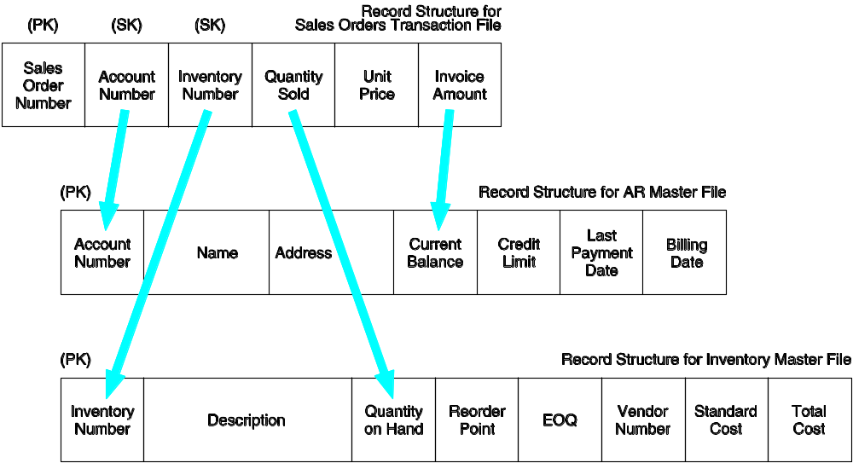
Updating Master Files: Primary Keys (PK) and Secondary Keys (SK)‏

Slide 37
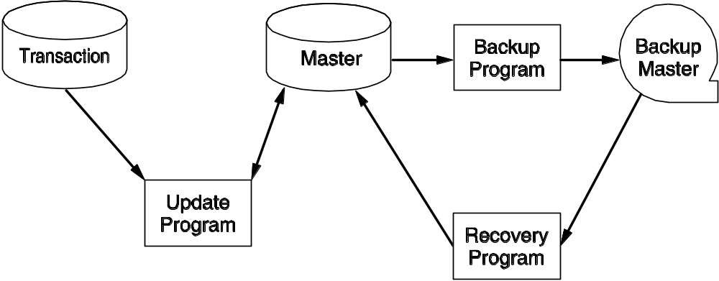
Database Backup Procedures
Destructive updates leave no backup.
To preserve adequate records, backup procedures must be implemented, as shown below:
  The master file being updated is copied as a backup.
  A recovery program uses the backup to create a pre-update version of the master file.

Slide 38
Computer-Based Accounting Systems
Two broad classes of systems:
  batch systems
  real-time systems
Notes:
31

Slide 39
Batch Processing
A batch is a group of similar transactions that are accumulated over time and then processed together.
The transactions must be independent of one another during the time period over which the transactions are accumulated in order for batch processing to be appropriate.
A time lag exists between the event and the processing.
Notes:
32

Slide 40
Advantages of Batch Processing
Organizations can increase efficiency by grouping large numbers of transactions into batches rather than processing each event separately.
Batch processing provides control over the transaction process via control figures.
Notes:
33

Slide 41
Real-Time Systems…
Process transactions individually at the moment the economic event occurs
Have no time lag between the economic event and the processing
Generally require greater resources than batch processing since they require dedicated processing capacity; however, these cost differentials are decreasing
Oftentimes have longer systems development time
Notes:
34

Slide 42
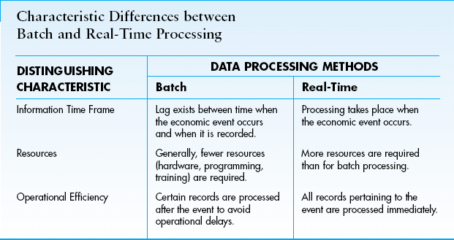
Batch vs Real-Time Systems

Slide 43
Why Do So Many AIS Use Batch Processing?
AIS processing is characterized by high-volume, independent transactions, such are recording cash receipts cheques received in the mail.
The processing of such high-volume cheques can be done during an off-peak computer time.
This is one reason why batch processing maybe done using real-time data collection.
Notes:
35

